Slide 1


Team 48
Dual plug EV charging power distribution device
ECE 445
Shuchen Wu, Haochen Zhang, Taiyuan Hu
Professor: Jonathon Schuh
TA: Hanyin Shao
5/2/2022
Notes:
Good afternoon everyone, we are Team 48. My name is Shuchen WU and they are my teammates, Haochen Zhang , Taiyuanhu. Our project is Dual plug EV charging power distribution dvice. Our instructor is prof. Jonathon Schuh, and our TA is Hanyin Shao.

Slide 2


Introduction
Background Problem
Solution
High-level Objectives
ECE 445 Team 48
GRAINGER ENGINEERING
Notes:
Now I will briefly introduce our project’s initial motivation, solution, and project high-level goals.

Slide 3
Introduction
Background Problem
Increasing possession of electric vehicles (EVs) in families
EV charger has one output plugs
Need manual operation to charge two EVs
Hard to benefit from off-peak electricity hours
ECE 445 Team 48
GRAINGER ENGINEERING
Notes:
As increasing possession of EVs in families, many families own two or more EVs. However, the EV chargers nowadays have only one output plug, which means, EV owners need to manually connect EV charger to their second EV after their first EV finishes charging. This requires extra effort and time because the EV owners need to wait until their first EV being fully charged in order to charge their second EV. In addition, EV owners are unlikely to benefit from off-peak electricity hours because it is not realistic for them to charge all of their EVs during midnight with the one output plug EV charger.

Slide 4
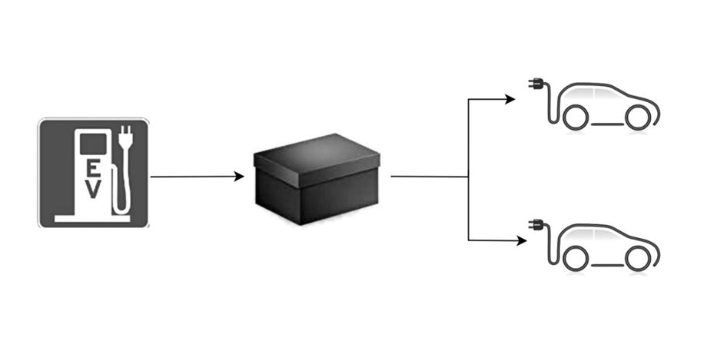
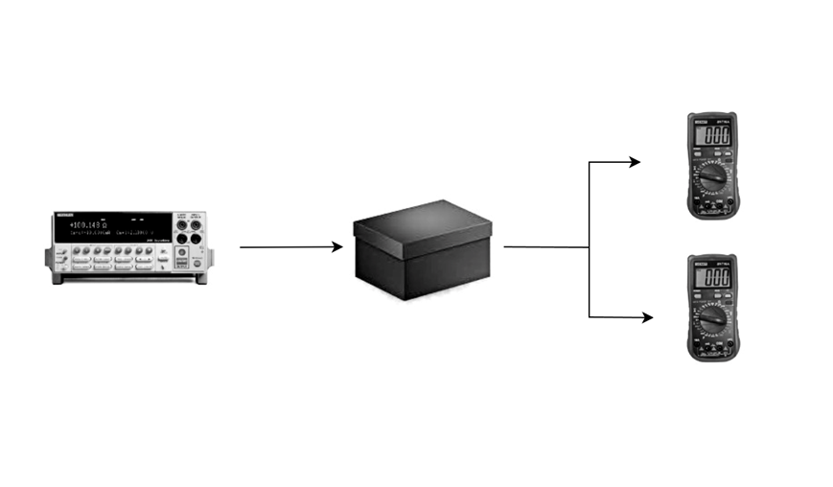
Introduction
Solution
Dual plug EV charging power distribution device
Split one plug of EV charger into two output plugs
Two operation modes
Even mode (evenly allocate power to the two output plugs)
Priority mode (allocate power to the two output plugs with current level set by user)
Accomodations for lab environment
Original idea
Accomodation for lab environment
ECE 445 Team 48
GRAINGER ENGINEERING
Notes:
Therefore, we want to build the dual plug ev charging power distribution device that is a supplementary device between EV chargers and electric vehicles. As you can see in the top right picture, in our original idea, the device is able to split power from EV charger into its two output plugs and charge the electric vehicles. In other words, this black box here is our device, and it takes the current from EV charger as input, and outputs current in two individual output plugs. Our device has two operation modes, one is the average mode, which both output plugs carry same amount of current. The second mode is priority mode, which the user chooses a priority output and set output current level for the priority output then the rest of the current will be allocated to the second output. However, our original design has limitations, we don’t have actual EV charger and EVs available for us to test. As a result, we decide to use a current generator in senior design lab as our device input, and use current meters to measure output current in order to test our device functionality.

Slide 5
Introduction
High-level Objectives
Both operation modes work as designed
The user is able to interact with the device through the user-interface subsystem
The device is able to measure current values in its output plugs and display the measurement
ECE 445 Team 48
GRAINGER ENGINEERING
Notes:
Here are three key features of our project. First, Both operation modes, the average mode and the priority mode, should function as designed. Second The user is able to interact with our device through the user interface subsystem, use button module to control, and use LCD module to get feedback. Last, the device should be able to measure current values in its two output plugs and display the measurement through LCD module.

Slide 6

Project Design
Block Diagram
Subsystems
ECE 445 Team 48
GRAINGER ENGINEERING
Notes:
Moving forward, we will talk about our project in more detail. Let’s first take a look at our block disgram.

Slide 7
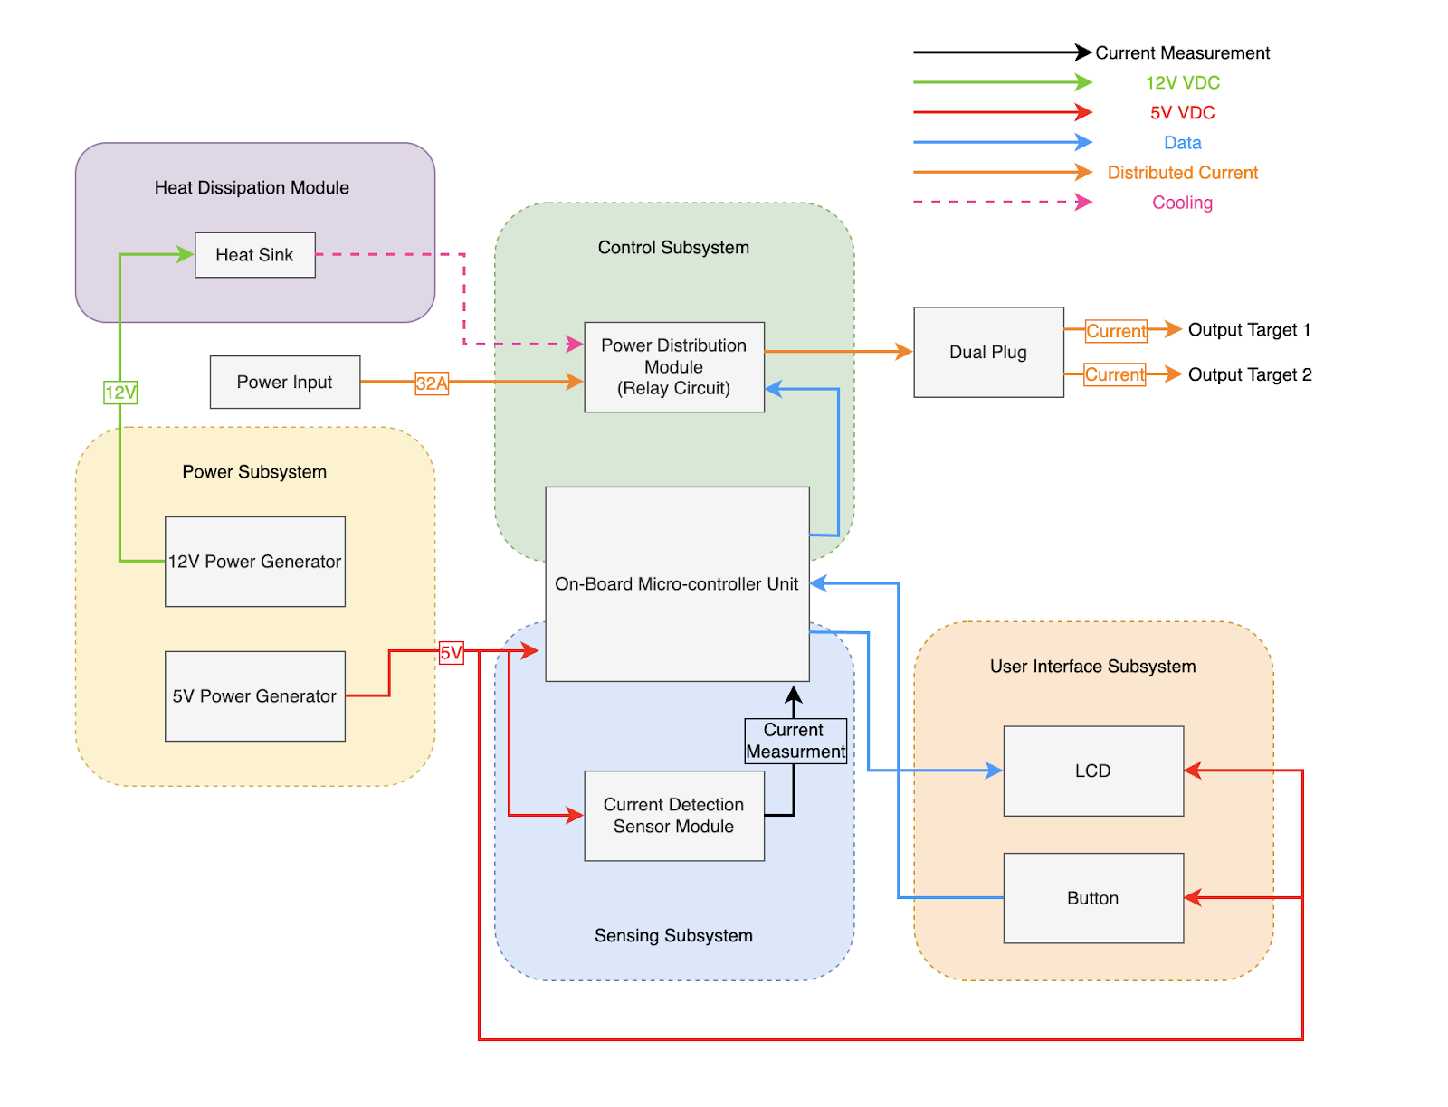
Block Diagram
ECE 445 Team 48
GRAINGER ENGINEERING
Notes:
As you can see in the block diagram. Our device has 4 subsystems, one heat dissipation moudule and one on-board microcontroller unit. The susbsystems are power subsystems, control subsystems, sensing subsystem, and user-interface subsystem. Because there are data interaction between MCU and other major susbsystems， we will also explain MCU individually later.

Slide 8

Power Subsystem
ECE 445 Team 48
GRAINGER ENGINEERING
Notes:
Let’ first begin with the Power subsystem of our device.

Slide 9
Power Subsystem
12V Voltage Battery
12V to 5V Converter
Modification
12V & 5V voltage generator
Requirement | Verification | Result
Provide steady 11.5-12V output for at least two hours. | Use voltage meter to measure battery output voltage when the device is on. | Partially verified. The battery dies after supporting the device for about an hour.
Requirement | Verification | Result
Provide steady 5V output. Output voltage is successfully applied to components on PCB. | Use voltage meter to measure. | Verified. Verified.
ECE 445 Team 48
GRAINGER ENGINEERING
Notes:
We use 12V voltage as power and control signal for the relay modules and we use 5V voltage for the PCB. In our initial design, we decided to use 12V battery and 12V to 5V converter as power supply. As you can see in the RV table above, for both of the components in power subsystem, we directly use voltage meter to verify the reliability of power supplies. And we found that the battery is not capable of supporting steady 12V voltage for enough long time. In addition, the voltage output of the battery gradually drops. As for the voltage converter, the functionality was achieved during verification, but it generated too much heat and occasionally failed due to overheating. Therefore we made some modification for the power subsystem.

Slide 10
Heat Dissipation Module
ECE 445 Team 48
GRAINGER ENGINEERING
Notes:
The second section is heat dissipation module.

Slide 11
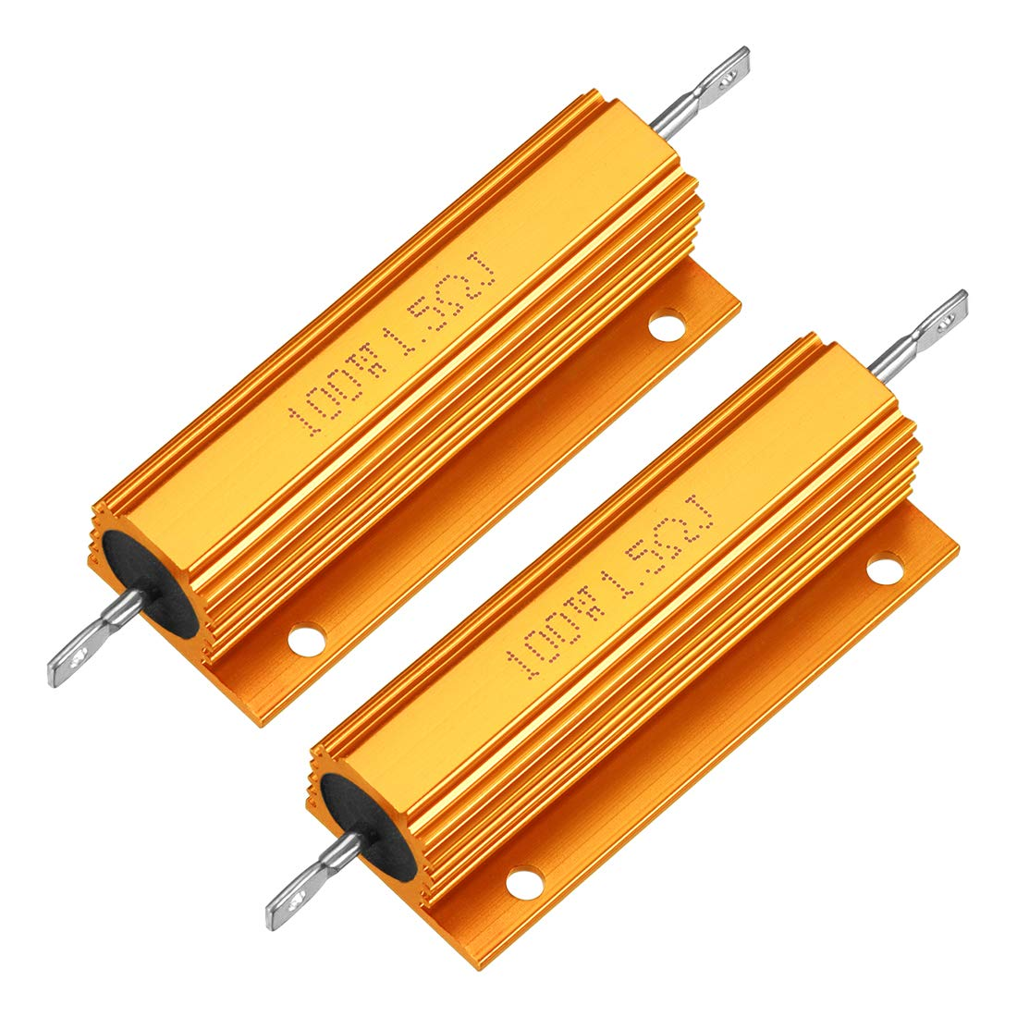
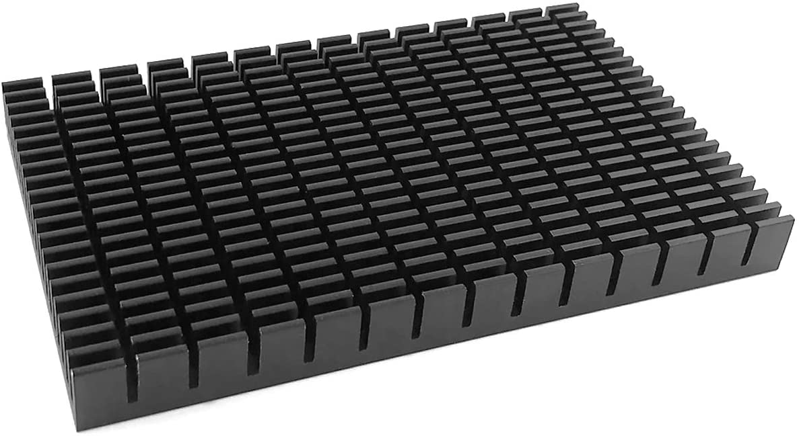
Heat Dissipation Module
Cooling Need Reference Link
Power Resistor with Aluminum Case
Aluminum Heat Sink
ECE 445 Team 48
GRAINGER ENGINEERING
Notes:
In the ourl design, our device is expected to operate at high current level, up to 32 Amps. The heat generated by power distribution module should be considered. As a result, we use 1.5 ohm power resistor with aluminum case in order to reduce the total generated heat and release heat. Our device is placed above an heat sink so that heat generation is further released. Due to the fact that we test and demo the project using only 1 Amp current, there is only little heat generated. Under such situation, we conclude the functionality of the heat dissipation module is verified. If better cooling porformance is needed, we will consider adding more features like fans or water cooling to our heat dissipation module.

Slide 12
Control Subsystem
Relay Module
ECE 445 Team 48
GRAINGER ENGINEERING

Slide 13
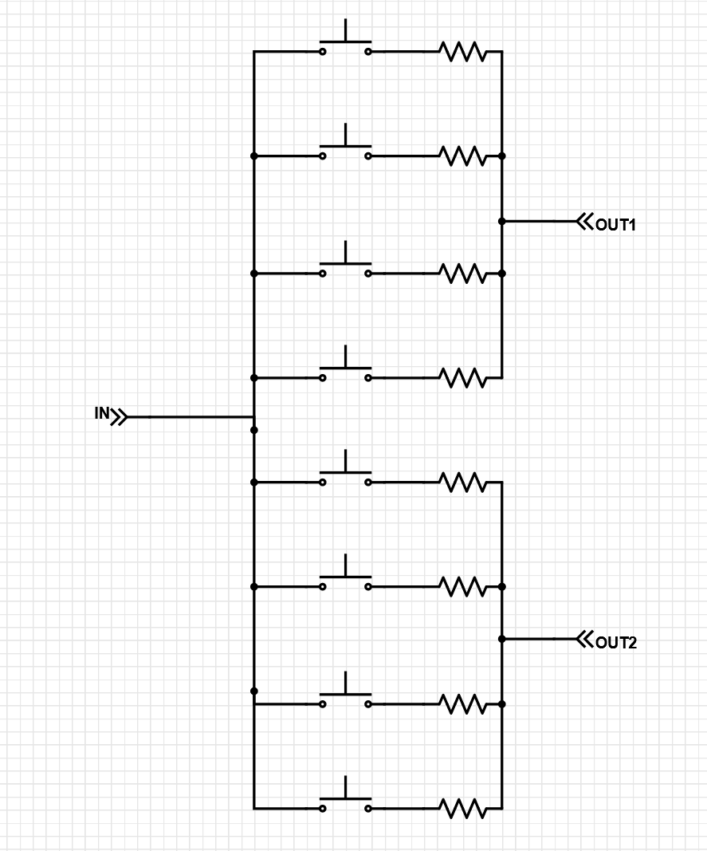
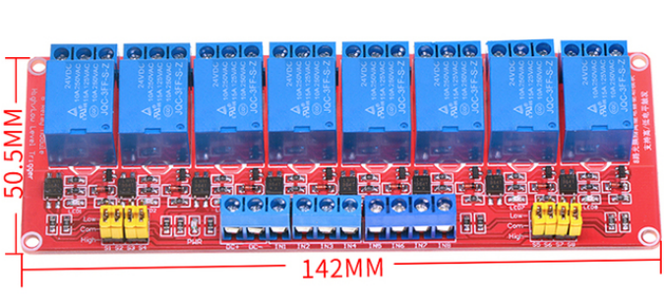
Control Subsystem— Relay Module
Relay Module
Relay module
ECE 445 Team 48
GRAINGER ENGINEERING

Slide 14
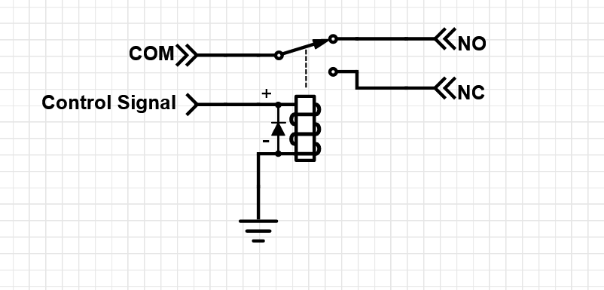
Control Subsystem— Relay Module
Relay Module
When the control signal is high(9-12V), NC and COM are connected.
When the control signal is low(0-2V), NO and COM are connected.
We connect NO to power input and COM to output.
ECE 445 Team 48
GRAINGER ENGINEERING

Slide 15
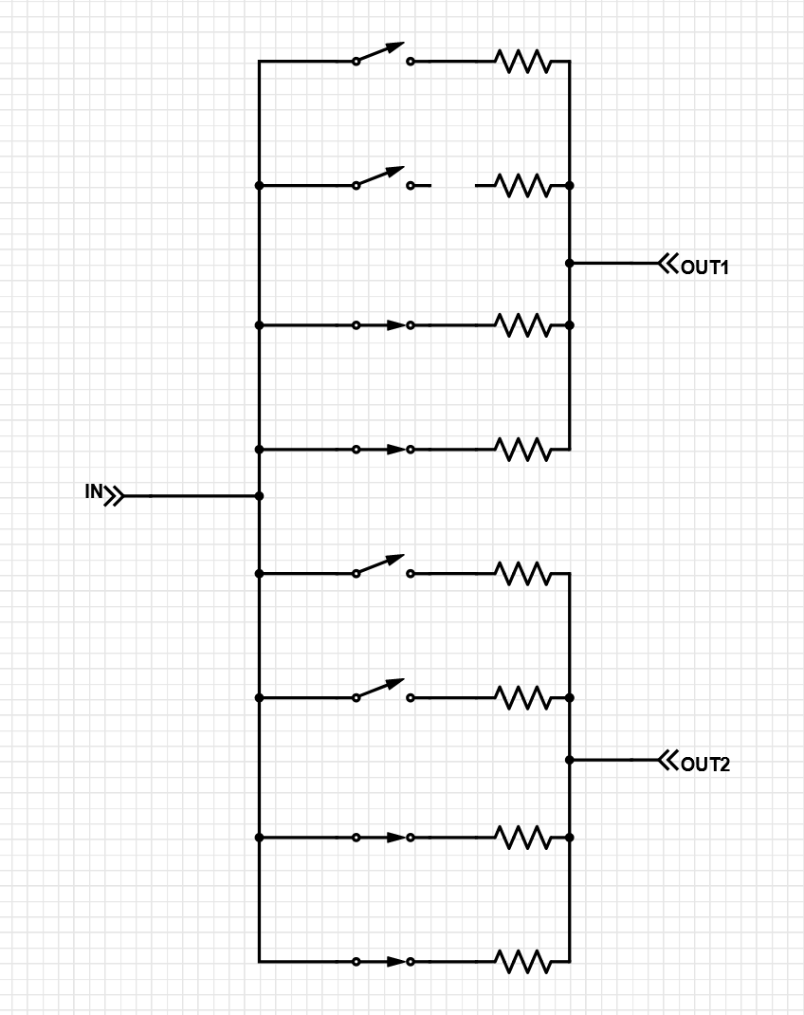
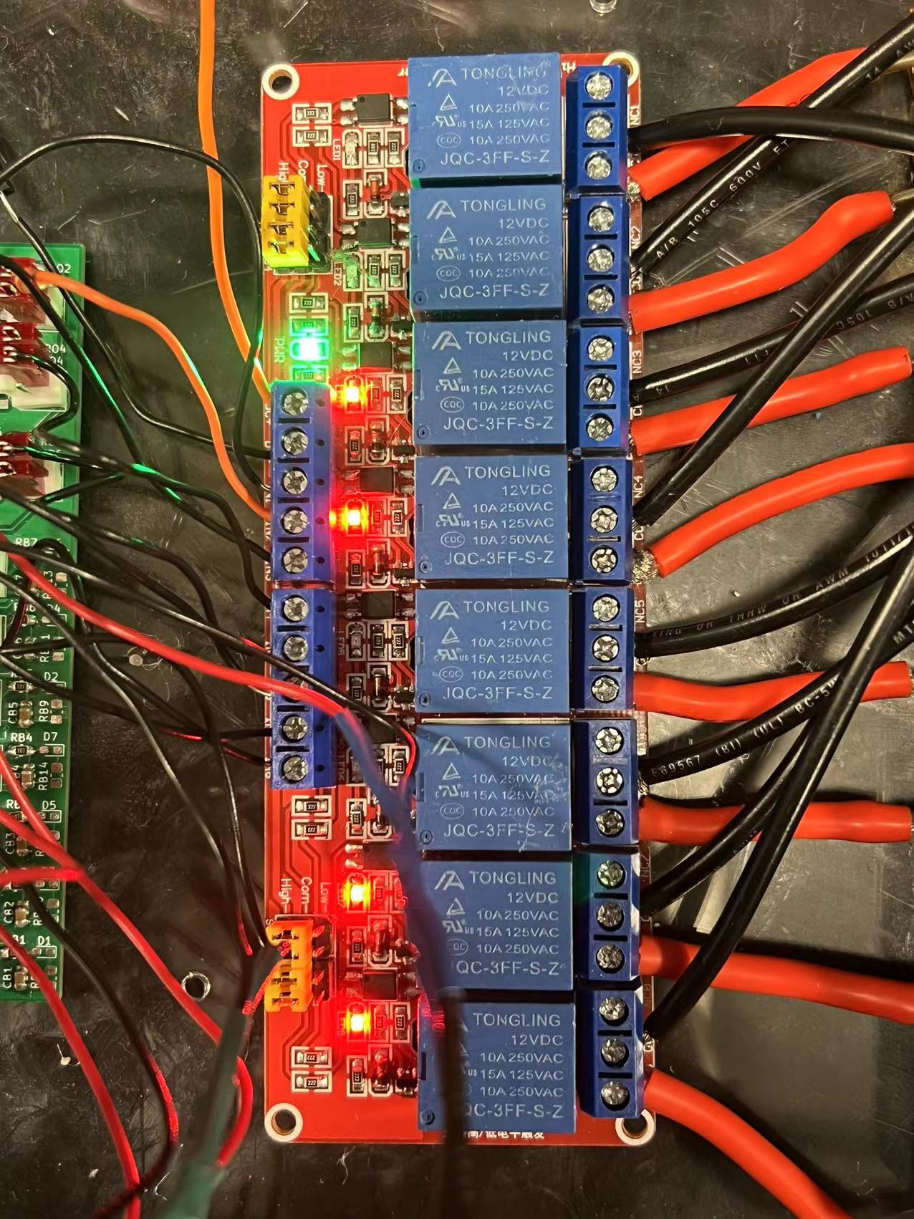
Control Subsystem— Relay Module
Even Mode
ECE 445 Team 48
GRAINGER ENGINEERING

Slide 16
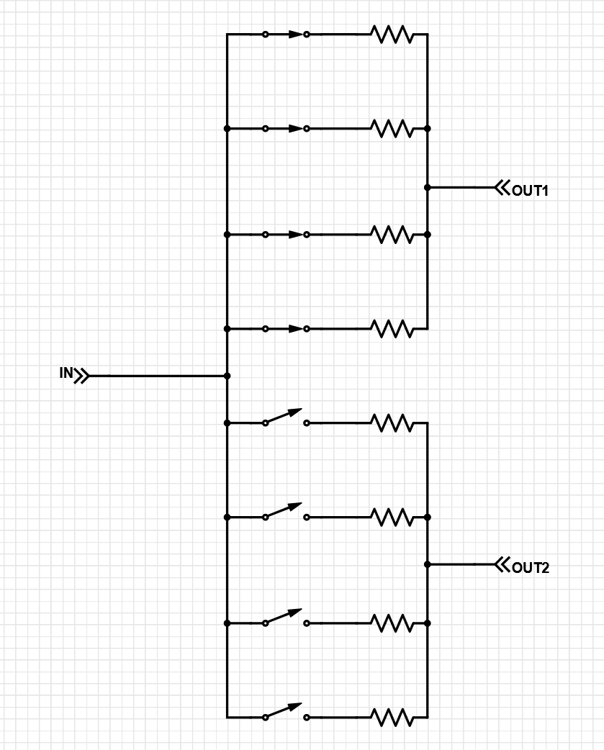
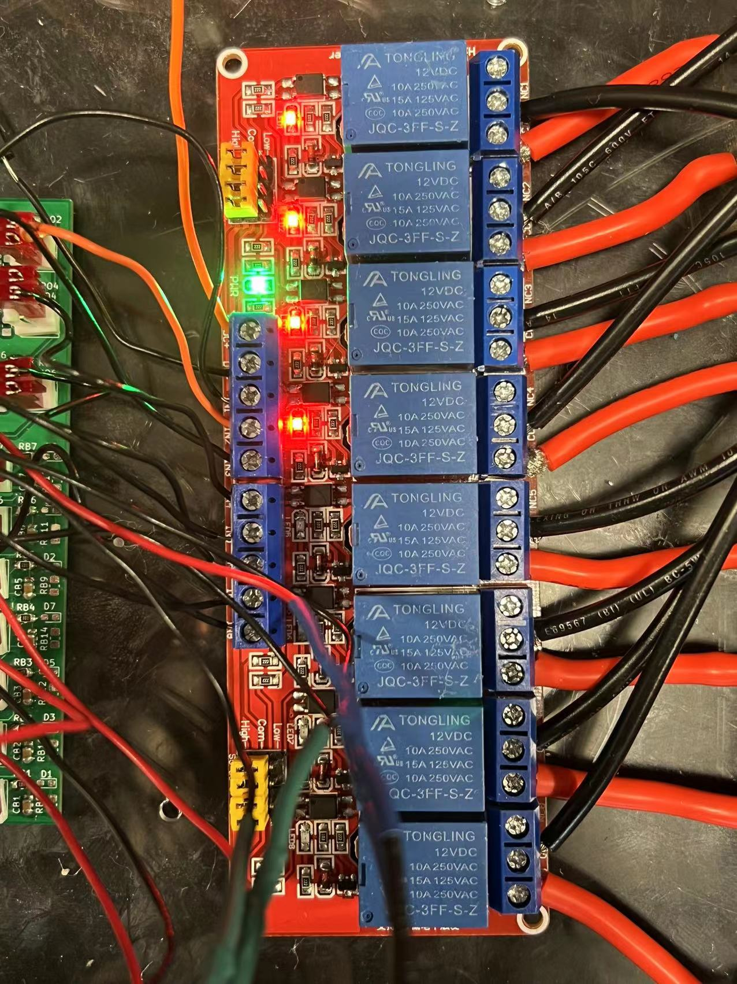
Control Subsystem— Relay Module
Mode 2-1
ECE 445 Team 48
GRAINGER ENGINEERING

Slide 17
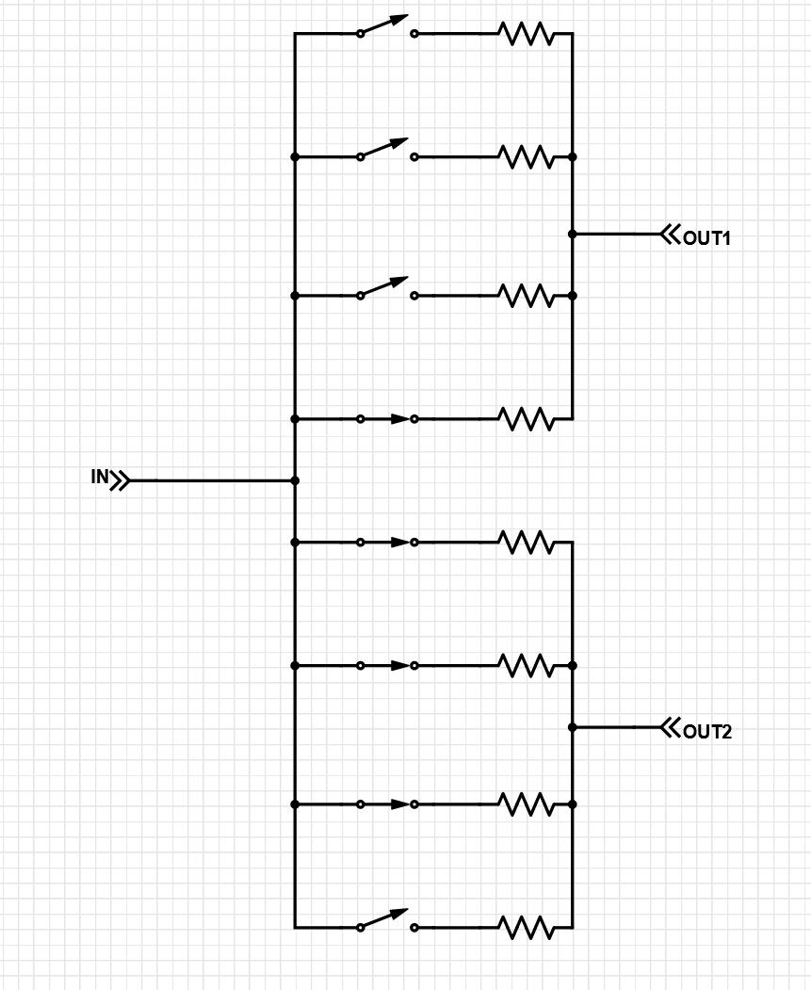
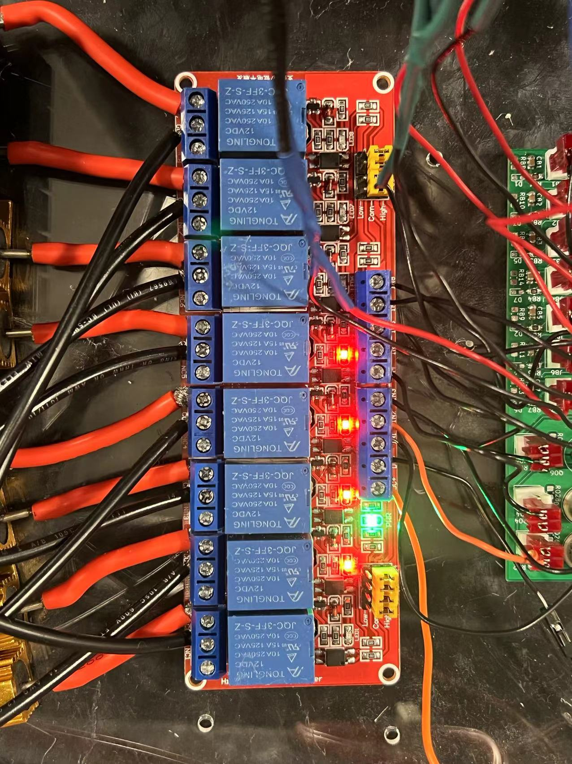
Control Subsystem— Relay Module
Mode 2-2
ECE 445 Team 48
GRAINGER ENGINEERING

Slide 18
Control Subsystem
Reversed Amplifier
ECE 445 Team 48
GRAINGER ENGINEERING

Slide 19
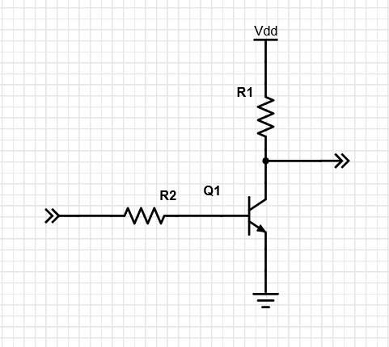
Control Subsystem— Reversed Amplifier
Reversed Amplifier
The digital control signal output by ATMEGA16A is either low(0-0.5V) or high(4.5-5V).
The control required by relay modules are either low (0-0.5V) or high(9-12V).
We need to amplify the signal of MCU so that it could successfully drive the relay successfully.
Reversed amplifier is used.
When the input is high(4.5-5V), output is low(0-0.5V)
When the input is low(0-0.5V), output is high(11.5-12V)
ECE 445 Team 48
GRAINGER ENGINEERING

Slide 20
Control Subsystem— Reversed Amplifier
Simulation Result of Reversed Amplifier
Input | Output
0V | 12V
0.5V | 11.99983V
4.5V | 20.813mV
5V | 20.482mV
ECE 445 Team 48
GRAINGER ENGINEERING

Slide 21
Control Subsystem— Reversed Amplifier
Reversed Amplifier Testing
Input(Low) | Output(High) | Input(High) | Output(Low)
10mV | 11.976V | 4.67V | 15mV
15mV | 11.972V | 4.73V | 14mV
11mV | 11.978V | 4.87V | 13mV
12mV | 11.966V | 4.93V | 15mV
11mV | 11.975V | 4.75V | 14mV
10mV | 11.978V | 4.76V | 14mV
10mV | 11.973V | 4.74V | 15mV
11mV | 11.969V | 4.82V | 11mV
ECE 445 Team 48
GRAINGER ENGINEERING

Slide 22
Control Subsystem
Subsystem Verification and Result
Requirement | Result
The relay circuits must successfully read and decode the control signal from MCU. The relay circuits must be able to change the current output based on the control signal. | Verified Verified
ECE 445 Team 48
GRAINGER ENGINEERING

Slide 23
Microcontroller Unit
(MCU)
ECE 445 Team 48
GRAINGER ENGINEERING

Slide 24
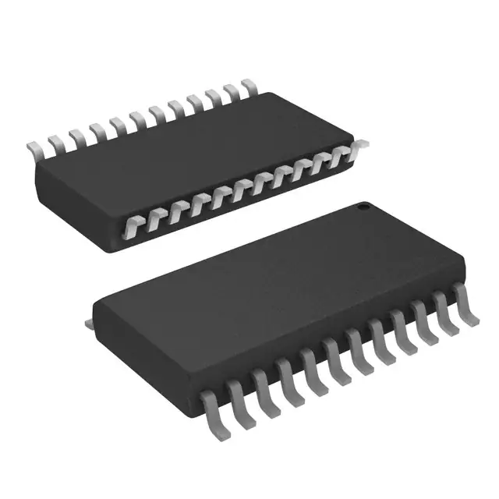
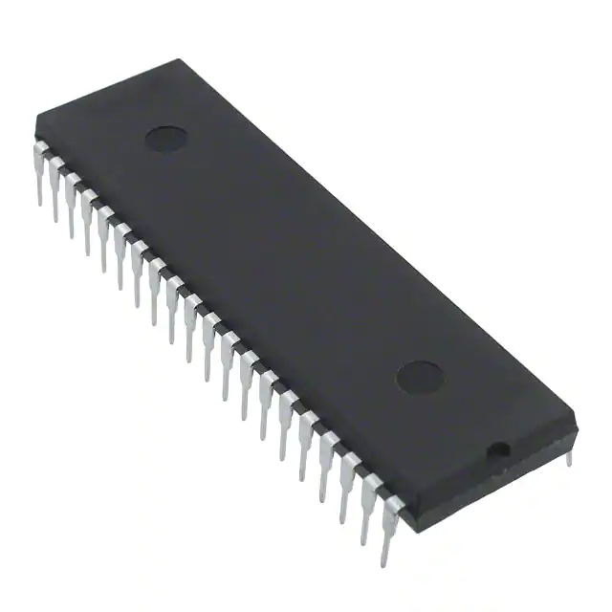
MCU Module
ATMEGA16
PCA95555D（）
ATMEGA16APU
PCA9555D
ECE 445 Team 48
GRAINGER ENGINEERING

Slide 25
MCU Module
Requirement | Result
MCU must interact with LCD module successfully MCU must interact with button module successfully MCU must interact with current sensor module successfully MCU must interact with relay module successfully MCU must coordinate the whole system | Verified. Verified. Verified. Verified. Verified.
ECE 445 Team 48
GRAINGER ENGINEERING

Slide 26
Sensing Subsystem
ECE 445 Team 48
GRAINGER ENGINEERING

Slide 27
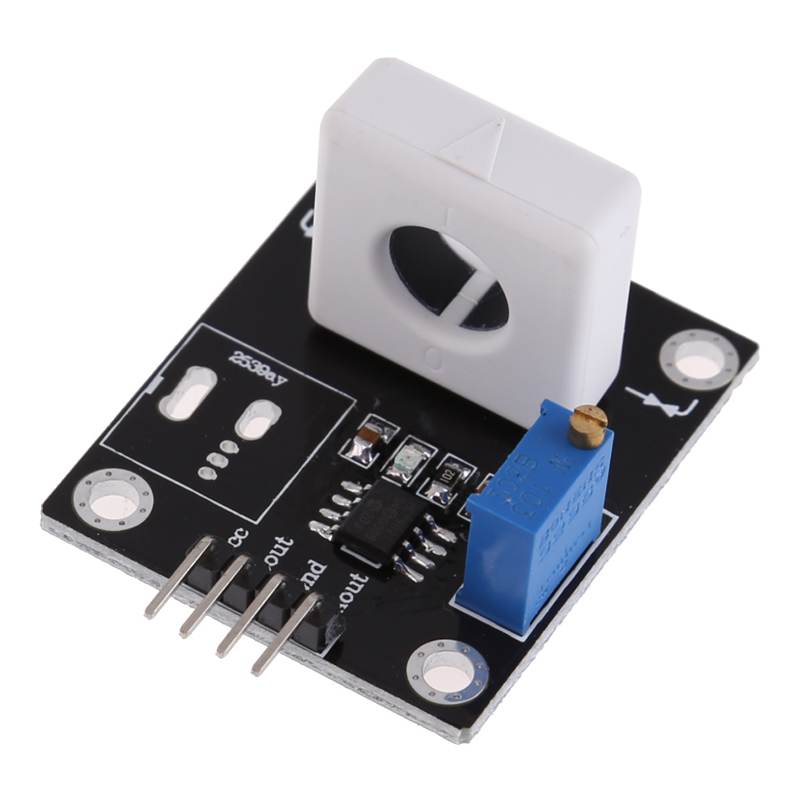

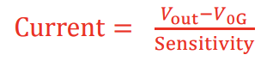
Sensing Subsystem—Current Sensor Module
Component: WCS1800
WCS1800 utilizes hall effect to measure current.
Formula for current calculation:
ECE 445 Team 48
GRAINGER ENGINEERING

Slide 28
Sensing Subsystem—Current Sensor Module
WCS1800
Requirement | Verification | Result
Current sensor should read correct current value up to 32A with precision within 10% | Compare the current sensor result and multimeter measurement. . | Partially verified. The error in some cases is larger than 10%.
ECE 445 Team 48
GRAINGER ENGINEERING

Slide 29
Sensing Subsystem— Current Sensor Module
Error and Explanation
Analog reading
The precision is limited to 0.0741A.
Internal resistance from multimeter
Manual factor
expected current value (A) | WCS1800 current reading (A) | multimeter current reading (A) | error (%)
0.25 | 0.22 | 0.260 | 18.2
0.5 | 0.44 | 0.482 | 9.5
0.75 | 0.74 | 0.741 | 0.1
1.0 | 0.96 | 0.999 | 4.1
ECE 445 Team 48
GRAINGER ENGINEERING

Slide 30
User-interface Subsystem
ECE 445 Team 48
GRAINGER ENGINEERING

Slide 31
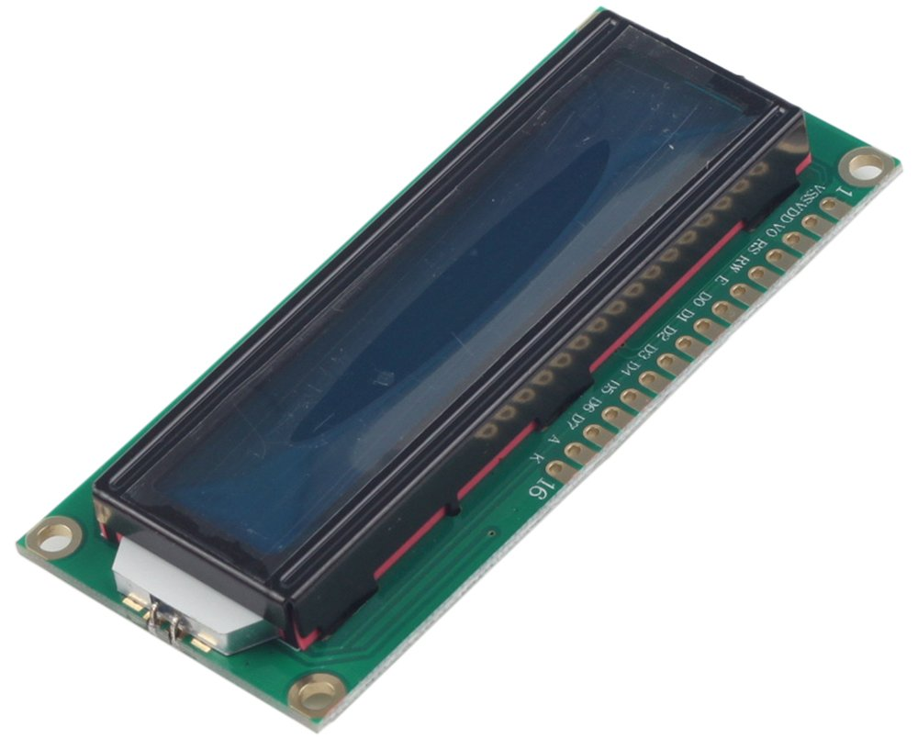
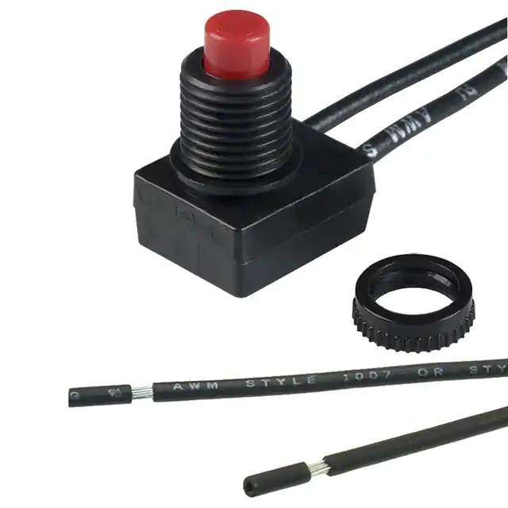
User-interface Subsystem
Display Module
Component: LCD 1602
LCD 1602 implements I2C protocol for communication.
Button Module
ECE 445 Team 48
GRAINGER ENGINEERING

Slide 32
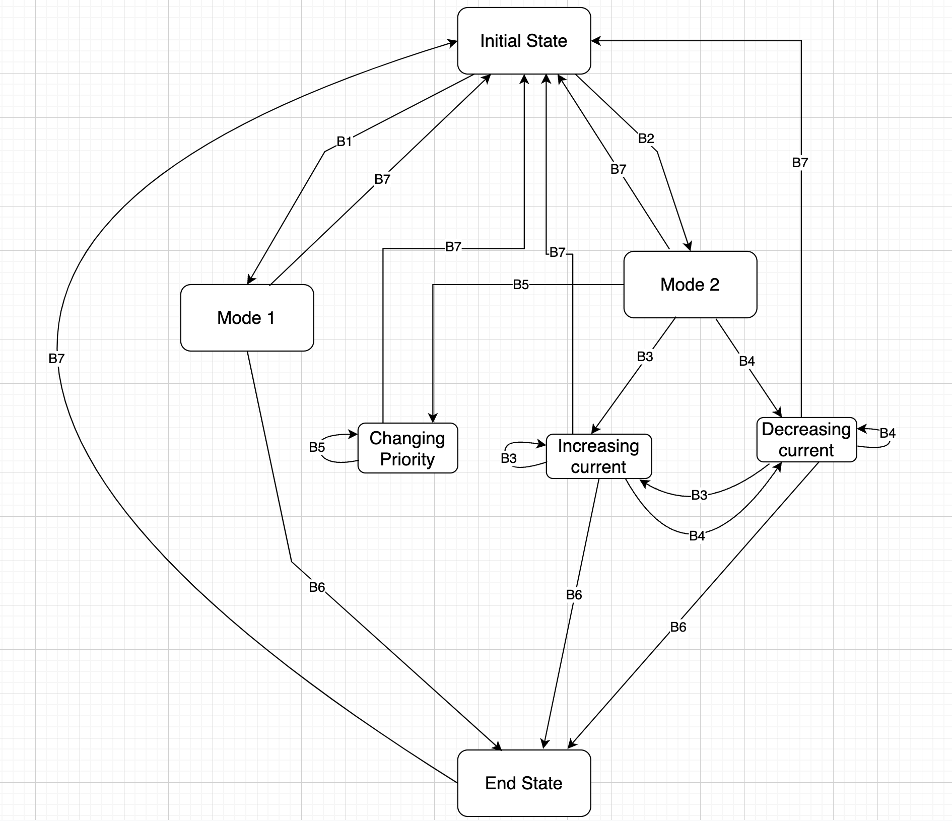
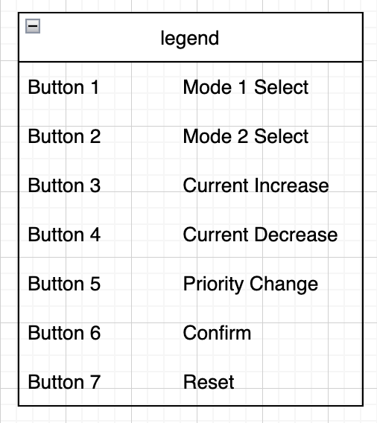
User-interface Subsystem— Button Module
State Diagram
ECE 445 Team 48
GRAINGER ENGINEERING

Slide 33
User-interface Subsystem
LCD1602
Button
Requirement | Verification | Result
LCD should display information of operation mode and current. | Check LCD display and multimeter to determine if the device is working as expected. | Verified
Requirement | Verification | Result
Button should be able to achieved the transition of state diagram. | Check LCD display and multimeter to determine if the device is working as expected. | Verified
ECE 445 Team 48
GRAINGER ENGINEERING

Slide 34

Conclusion
Result
Challenge
Future Work
DEPARTMENT / UNIT NAME
GRAINGER ENGINEERING

Slide 35
Conclusion
Result
Challenge
All subsystems and high level requirements are accomplished
When designing PCB, pin assignment should be handled carefully
ECE 445 Team 48
GRAINGER ENGINEERING

Slide 36
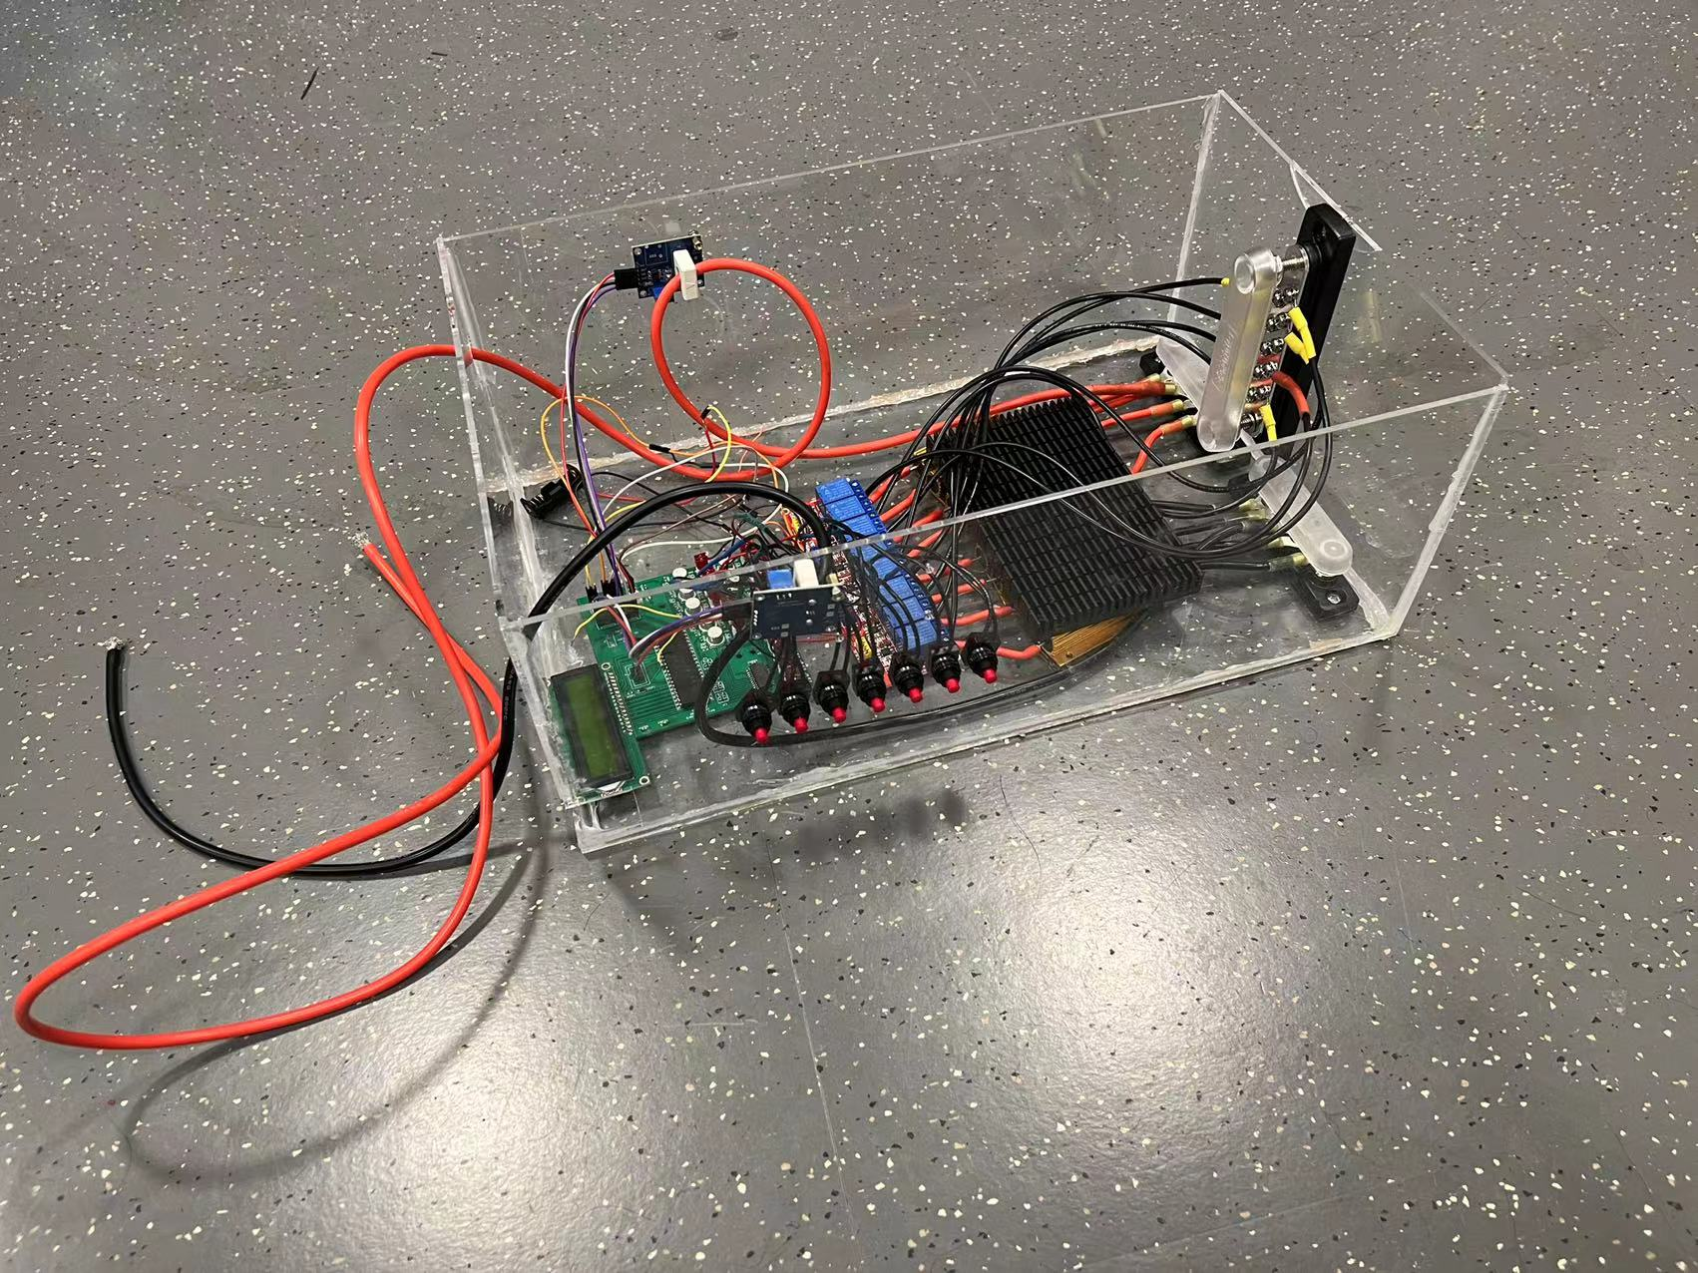
Conclusion
ECE 445 Team 48
GRAINGER ENGINEERING

Slide 37
Conclusion
Future Work
Make the device compatible with the real EV charger and EVs.
If one output plug is disconnected, the device should automatically allocate all of the input power to the other connected plug.
ECE 445 Team 48
GRAINGER ENGINEERING

Slide 38
Thank You For Watching
ECE 445 Team 48
GRAINGER ENGINEERING

